Slide 1
How Important is Three Point Shooting in the NBA Today
By
Jose Muniz
And
Michael Seman
Notes:
After agreeing to work together, It took all of 5 minutes for Jose and I to get into a heated debate about who was the best NBA team of all time. I of course chose the Michael Jordan bulls, while Jose chose Steph Curry and Kevin Durants Golden State Warriors.
While I was unable to open Jose’s eyes to true greatness, we both agreed that Steph’s Warriors and 3 point shooting in general had changed the game…
This is what sparked us on our journey of exploration into the 3 point shot with our project.

Slide 2
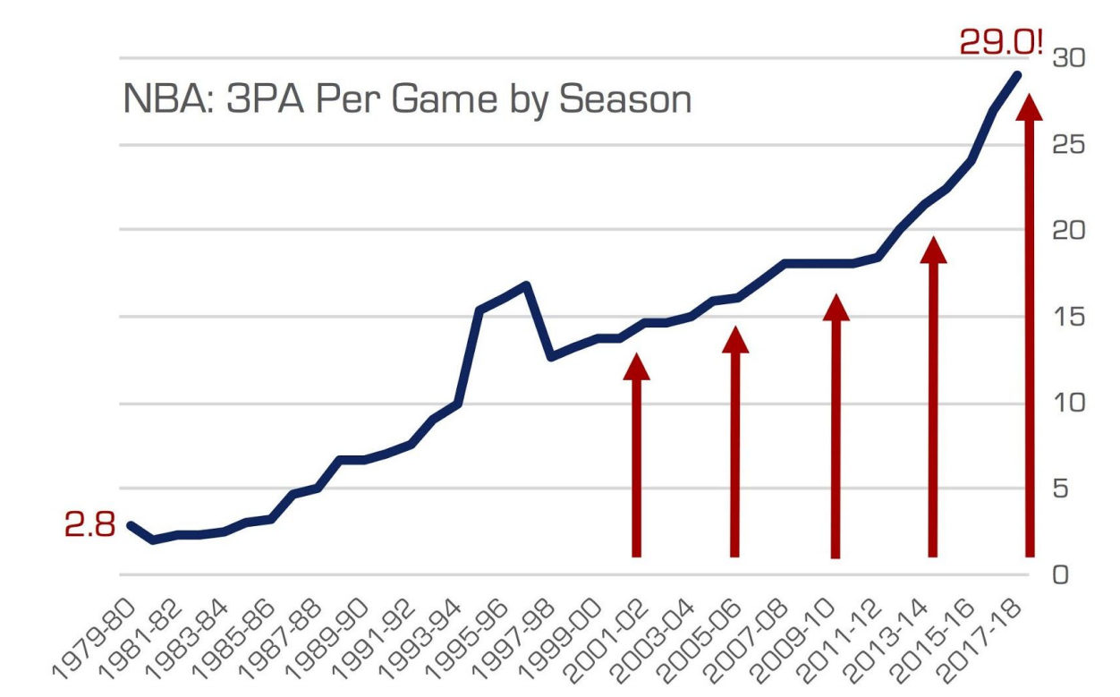
The History of the Three Point Shot
The Three Point Line was introduced to the NBA in 1979.
(coincidentally Magic Johnson and Larry Bird's rookie seasons)
The NCAA did not introduce the Three Point Line until 1986.
(Michael Jordan played college basketball at North Carolina without a 3-point line)
Five years after its inception, NBA teams were only averaging 2.4 three-point attempts (3PA) per game. In 2018 Teams averaged 29.
(James Harden alone averaged ten in 2018.)
Notes:
While the NBA was created in 1949, the 3 point shot wasn’t introduced until 30 years later.
In the first 5 years of the 3 pt shot, teams were taking less than THREE 3pointers per game….
In the year Steph Curry and Kevin Durants Warriors won the title, teams were averaging 29, 10 x that amount

Slide 3

Our Goal
To find out how the 3-point shot affects players and teams in the NBA
Our Dataset
Our Dataset was taken from Basketball-Reference.com. It contains 2020/2021 NBA Season individual player statistics.
Effective Field Goal Percentage (eFG%) is a metric used by data analysts in the NBA to determine the effectiveness of a player’s field goals adjusted to account for the fact that 3 points is worth more than regular field goals. Formula for eFG%: (FG+0.5*3P)/FGA
Aside from finding and deleting players who played too few games, the main challenge with the dataset was deciding what to do with players who switched teams during the season.
In order to add Team Win/Lose records to the dataset, we had to use an Excel sheet instead of a CSV and create a relationship in Tableau.
Notes:
Effective field goal percentage is a stat that accounts for the fact that a three-point field goal is worth more than a two-point field goal
The biggest challenge with the dataset was what to do with players who switched teams during the season
We chose to keep players who switched teams stats together with the player which caused our team stats to be slightly off, but not enough to change rankings or the numbers in a significant manner

Slide 4
Findings and Analysis
While NBA players tend to hit their peak around age 27, 3-point shooting seems to peak a little later (29).
Most NBA players are younger (between 22-24) but the better teams tend to have the oldest rosters.
There is a strong correlation between 3-point percentage and effective field goal percentage showing that players who can shot 3s above 36% contribute more to offense than those who don’t.
And while there isn’t a strong correlation between 3-point attempts and effective field goal percentage, we can see by the ranks of the top scorers in the NBA that 3-point attempts does have a strong correlation with how many Point per Game a player averages regardless of percentage.
Teams with a higher 3-point shooting percentage tend to have higher wins.

Slide 5

Conclusions
There is a direct correlation between team wins and 3-point shooting percentage, for example the most recent dynasty (Golden State Warriors) are also the greatest 3-point shooting team of all time.
There is also a direct correlation between 3-point shooting and effective field goal percentage, showing that players who shoot and make more 3s are having a much bigger impact on offense than those that don’t. As a result, shooting 3s is now a must have skill to even enter the NBA.
Areas to improve: Our data set only covers 2020/2021 season.
Possible solution: Adding multiple years of player data from 1979 to current year.
Future research: Adding in salary to see whether 3-point shooting is over/under valued.

Slide 6
References:
https://shottracker.com/articles/the-3-point-revolution
https://www.basketball-reference.com/leagues/NBA_2021_per_game.html - dataset
https://www.sportscasting.com/the-exact-age-that-nba-players-are-in-their-prime/
https://www.espn.com/nba/standings/_/season/2021/group/league - dataset(2)
https://www.espn.com/nba/stats/team/_/season/2021/seasontype/2/table/offensive/sort/threePointPct/dir/desc

